Slide 1
ANALYSIS ON FACEBOOK DATA
SUBMITTED BY:- DHRUVA PRAJAPATI

Slide 2
WHAT I HAVE DONE IN PROJECT
ANALYSIS ON FACEBOOK DATASET ON BELOW OBJECTIVES

Slide 3
OBJECTIVES:-
WHAT IS THE COUNT OF USERS HAVING BIRTHDAY
ANALYSIS ON WHICH CATEGORY OF GENDER HAS MORE FRIENDS
WHAT IS THE DISTRIBUTION OF TENURE ACROSS DIFFERENT CATEGORIES OF GENDER
WHAT IS THE MAXIMUM AGE-GROUP OF FACEBOOK USERS
HOW MANY USERS HAVE NO FRIENDS
WHICH CATEGORY OF GENDER RECEIVED MAXIMUM LIKES
HOW MANY LIKES RECEIVED THROUGH MOBILE AND WEBSITE GENDER-WISE
ANALYSIS ON USE OF FACEBOOK OVER YEAR
WHAT IS THE COUNT MOBILE AND WEBSITE USER BY AGE
TOP TEN USERS WITH MAXIMUM FRIEDNS COUNT

Slide 4
1. WHAT IS THE COUNT OF USERS HAVING BIRTHDAY
Most of the users are having birthday as 1st which is uneven
This may be because of default setting provided by facebook

Slide 5
2. ANALYSIS ON WHICH CATEGORY OF GENDER HAS MORE FRIENDS
Female users are having more friends as compared to male users
Surprising, the count of male users are more compared to female users

Slide 6
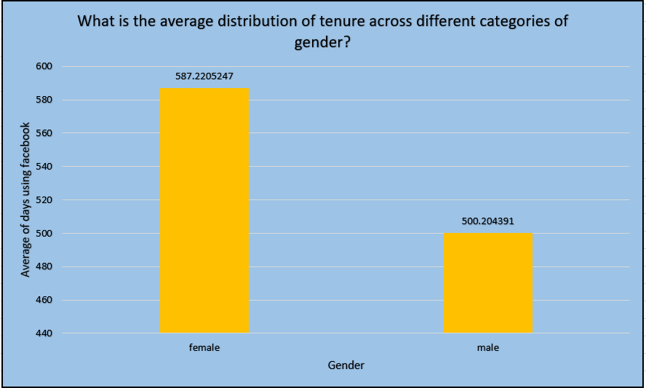
3.WHAT IS THE DISTRIBUTION OF TENURE ACROSS DIFFERENT CATEGORIES OF GENDER
The average usage of facebook is done maximum by female users as compared to male users

Slide 7
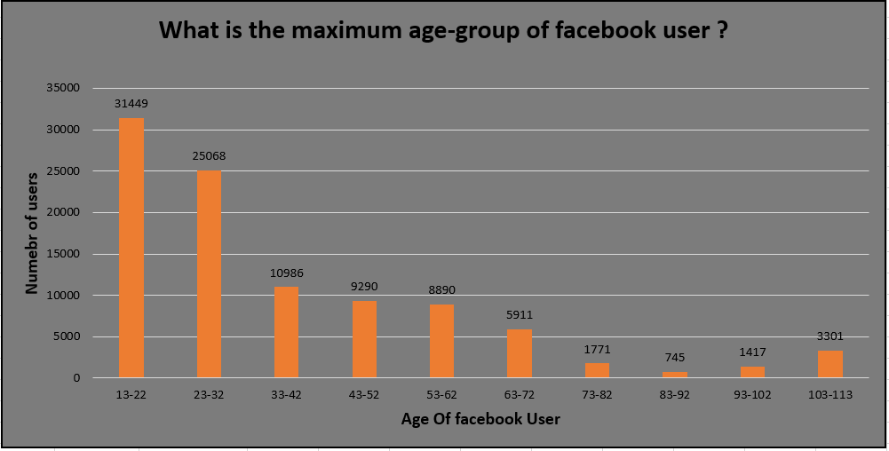
4. WHAT IS THE MAXIMUM AGE-GROUP OF FACEBOOK USERS
We can infer, that age-group 13-22 are having maximum of facebook users
Surprisingly, there are facebook user of age-group 103-113 which are certainly the fake users

Slide 8
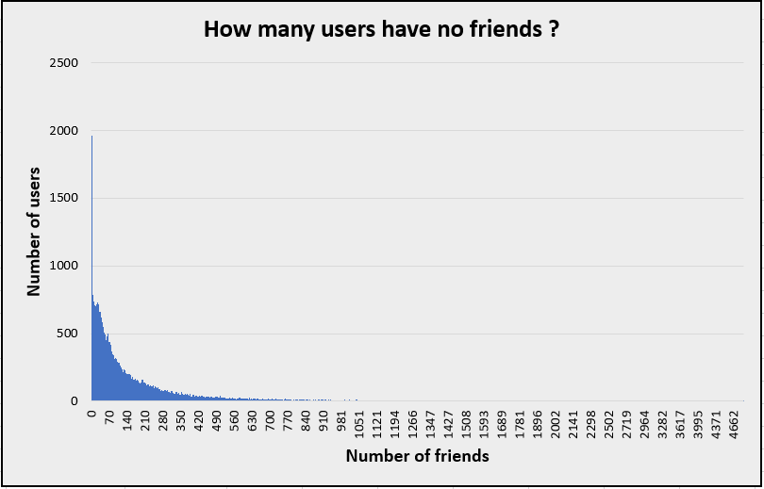
5.HOW MANY USERS HAVE NO FRIENDS
We can analyze that more than 1900 users have 0 friends
Only few users have friends more than 450

Slide 9
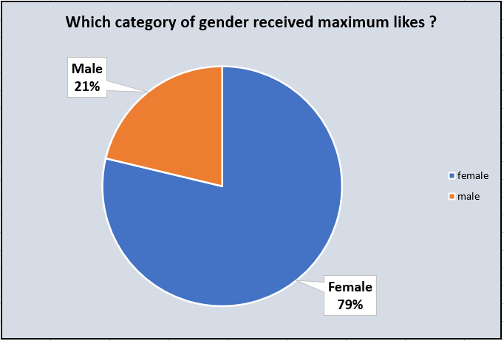
6. WHICH CATEGORY OF GENDER RECEIVED MAXIMUM LIKES
Surprisingly, though the male users are more compared to females users
Female users received the maximum percent of likes compared to male users

Slide 10
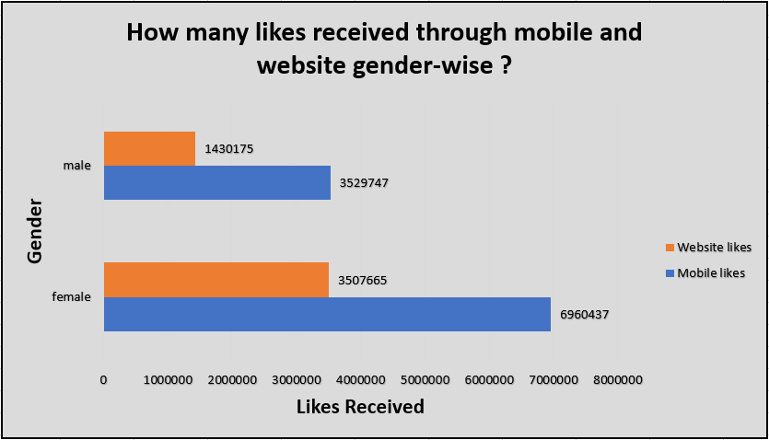
7.HOW MANY LIKES RECEIVED THROUGH MOBILE AND WEBSITE GENDER-WISE
Most of the users recevied likes through mobile
Therefore, many user prefer mobile to use facebook instead of handling it through website

Slide 11
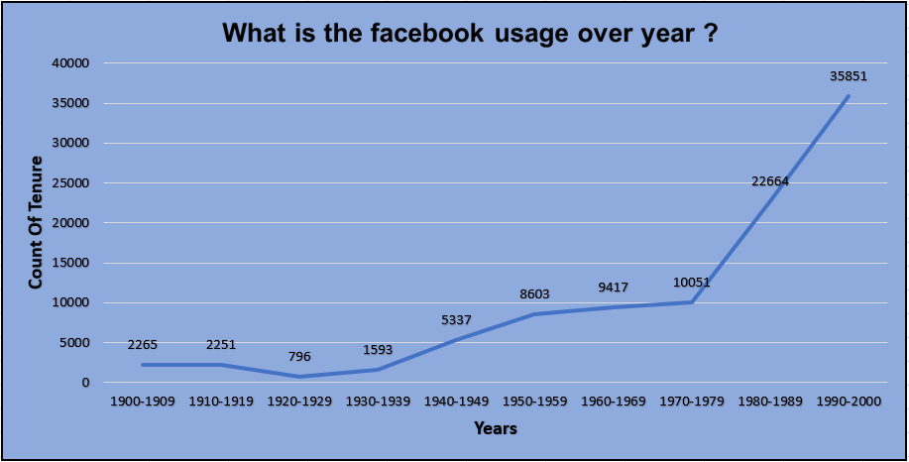
8.ANALYSIS ON USE OF FACEBOOK OVER YEAR
From the below-given trendline in graph we observe that the popularity and the usage of facebook is increasing over a year

Slide 12
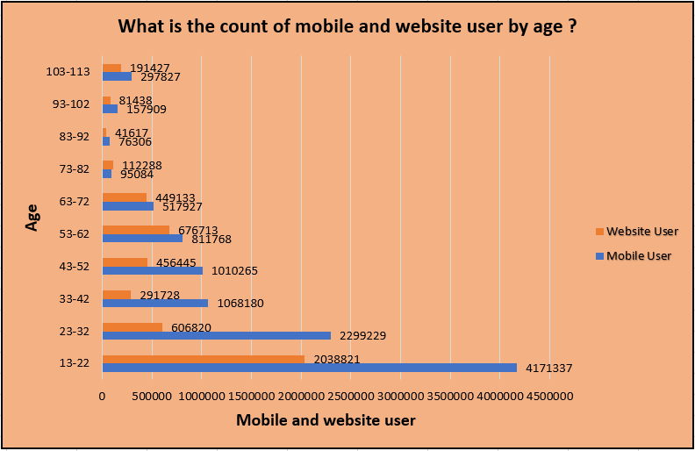
9. WHAT IS THE COUNT MOBILE AND WEBSITE USER BY AGE
The use of Facebook through mobile is prevalent in the younger age as compared to other age-group
User at the age of 103-113 are basically the outliers as they stood out against the different age-group

Slide 13
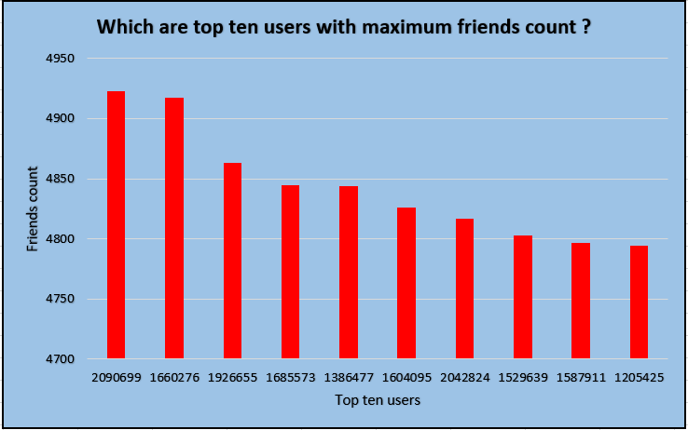
10. TOP TEN USERS WITH MAXIMUM FRIEDNS COUNT
Below given graph list the top ten users having maximum friends count
User id 2090699 and 1660276 are nearly equal in total friends count

Slide 14
Summary
Thus we have analyzed that there are many fake users having age-group of 100-113 because they use the default settings provided by facebook while creating an account,there were operating facebook account through mobile as compared to website, more than 1900 of users were having 0 friends,though the male users were more in count, female users were receiving more likes compared to male user
Handled the null value of gender and tenure variable
For gender variable, we handled by dropping the records having null value
For tenure variable, we replaced the null value by calculating the median of tenure variable
Please find the link attached below for watching the video regarding ppt explaination
Project presentation

